Slide 1
Cascade Metropolitan District # 1
Annual Town Hall Meeting 2025

Slide 2
CMD #1 Structure
Special District (local government)
Elected/appointed Board of Directors
Professional Management by WSDM District Managers
Legal support as needed
Auditors
Approximately 350 accounts

Slide 3
CMD #1 Operational Expenses
Directors are volunteers
Management expenses include
Billing
Mailing
Accounting
Website
Special District compliance filings and other requirements
Customer interaction
Account transfer
Legal expenses include
Support as needed
Auditors
Insurance

Slide 4
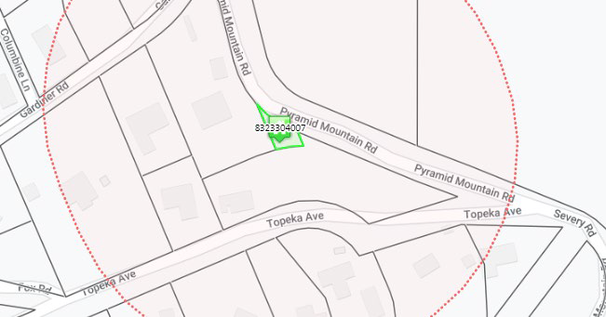
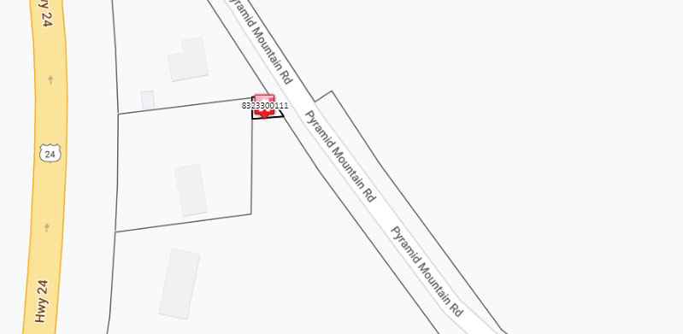
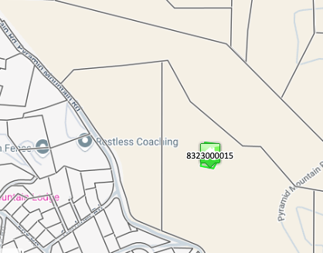
CMD #1 Current Public Infrastructure Projects
No current projects
CMD #1 is in the process of disposing a few parcels of property
Parcel No: 8323304007
Parcel No: 8323300111
Parcel No: 8323100015

Slide 5
CMD #1 Current Bond Status
Residential accounts are paying $134 per month through 2036
The new amount covers debt service and operational expenses with minor annual adjustments for changes in operational costs
CMD #1 exists only to service the bond debt
Does not operate a water system
Will not own any property after this year
Households receive two water-related bills per month
One for CSU water and operations
One for CMD #1 debt service

Slide 6
Current Debt Status (cont.)
Bond Amounts | Lender/Trustee | Interest Rate | Issued | BALANCE AS OF 12/31/2025
Series 2023A:$4,480,000 | UMB BANK | 5.00% | 12/01/2023 | $3,980,000
Maturity Date: Dec. 1, 2036 | UMB BANK | 4.75% | 6/4/2015 | 3,200,000.00

Slide 7
Current Unaudited Financial Statements

Slide 8
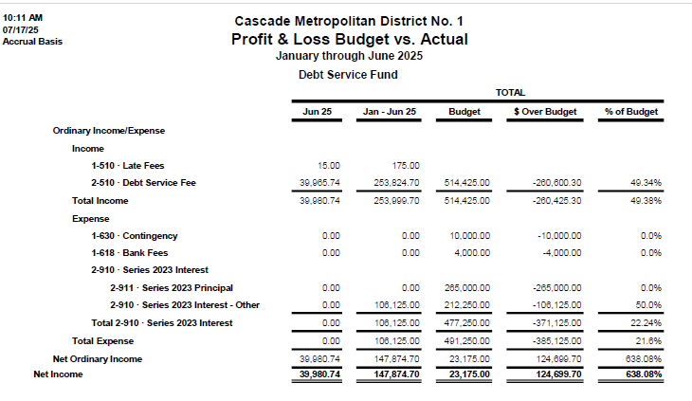
Current Unaudited Financial Statements

Slide 9
Questions?

